Slide 1


Real-time Twitter data analysis using Hadoop ecosystem -Dr. Amir Esmailpour
Vibha Mohankumar
Sharan Ajay Raj Paniya Raj
Shalini Garikapati

Slide 2
Introduction
Objective : The objective of this project was to determine, analyze, and visualize the sentiment in tweets pertaining to the 2020 US Presidential Election.
What is Twitter data?
Massive amount of data collected by either the user, the access point, what’s in the post and how users view or use your post.
What is sentiment analysis on twitter data?
It is an automated process of analysing text data that automatically identifies sentiments within text. This analysis helps to understand the view of the people towards a specific topic or subject.

Slide 3
Background
Data is generated exponentially in the current world.
The opinions of people are expressed in different microblogging sites which amounts to a lot of data.
These opinions are used in improving productivity, usefulness, functionality of product or application or technique or any entertainment resource
Evolvement of modern technologies like Cloud Computing and Big data gave many sophisticated ways to store data.
Various data models such as the Hadoop framework are used to handle this data which helps in taking better business/political decisions.
One such networking site is Twitter. Twitter data is a valuable source of information for marketing intelligence and trend analysis in all industries
Twitter generates a lot of data , a rule based approach is used for the sentiment analysis.

Slide 4
What is Sentiment Analysis?
It is the process of determining the emotional tone behind a series of words, used to gain an understanding of the attitudes, opinions and emotions expressed within an online mention. Usually, besides identifying the opinion, these systems extract attributes of the expression e.g.:
Polarity: if the speaker expresses a positive or negative opinion,
Subject: the thing that is being talked about,
Opinion holder: the person, or entity that expresses the opinion.
Semantic Analysis Algorithms (refining the tweets)
There are many methods and algorithms to implement sentiment analysis systems, which can be classified as:
Rule-based systems that perform sentiment analysis based on a set of manually crafted rules.
Automatic systems that rely on machine learning techniques to learn from data.
Hybrid systems that combine both rule based and automatic approaches.
Sentiment Analysis as a rule-based approach

Slide 5
Primary Design
Load
Data Retrieval: Data is retrieved from Twitter API using specific keywords.
Refine
Data Storage: The stream of tweets that ingests the data into Hadoop distributed File System which is a data link.
Data Processing: We use apache hive to create a sentiment score for each tweet. Hive is the defector standard for SQL interaction with Hadoop data allowing us to pull all the data with SQL.
Data Analysis
Visualize
Data Representation: Using hive script the data is visualized. The data is represented in the form of classified tweets i.e. positive, negative and neutral.
All the above steps are performed on Hadoop Ecosystem.

Slide 6
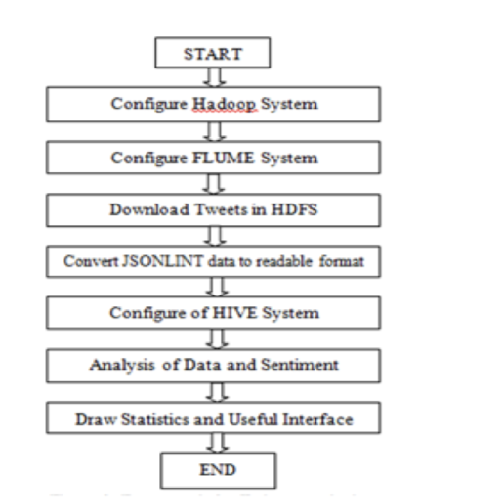
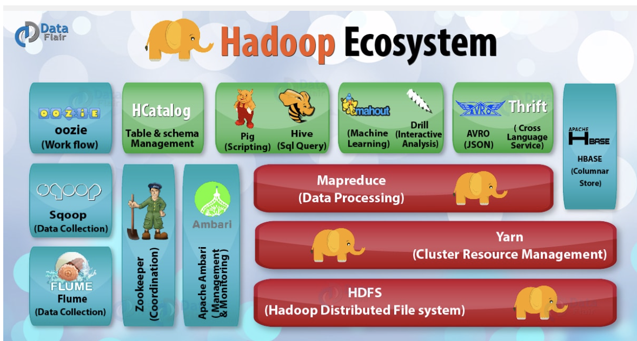
Hadoop Ecosystem

Slide 7
Hadoop Ecosystem
Hadoop is an open source framework that allows to store and process big data in a distributed environment across clusters of computers using simple programming models.
HDFS is the primary storage system for Hadoop. HDFS is a java-based file system that provides scalable, fault tolerance, reliable and cost-efficient data storage for Big data. There are two major components of Hadoop HDFS- NameNode and DataNode.
NameNode is also known as master node. NameNode doesn’t store actual data or dataset. NameNode stores metadata i.e. number of blocks, their location, on which Rack, which DataNode the data is stored and other details. It consists of files and directories.
DataNode is also known as Slave node. HDFS DataNode is responsible for storage of actual data in HDFS. DataNode performs read and write operation as per the request of the clients.

Slide 8
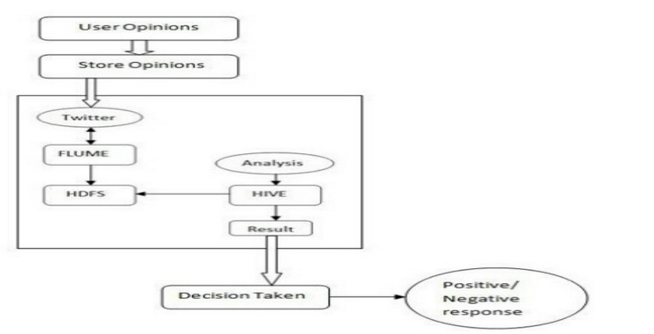
Methodology
A tool that can easily handle the data in minimum time limit is required to analyze large and complex data. For this purpose, Apache Flume and Hive query language were used. These are open source, scalable and fault tolerant framework.
Data analysis transformation for large and complex data was performed using HQL. HQL is like SQL i.e. Structured query language.
The various steps required for data ingestion, data storage and data process are:
Create a Twitter Application
Data Ingestion using Apache Flume
Create an external table using Hive
The various steps required for data ingestion, data storage and data process are:
Create a Twitter Application
Data Ingestion using Apache Flume
Create an external table using Hive

Slide 9
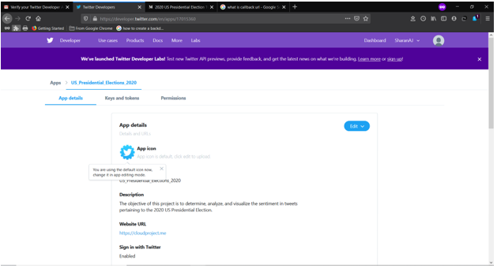
First step in obtaining twitter data
A twitter app was created in apps.twitter.com.

Slide 10
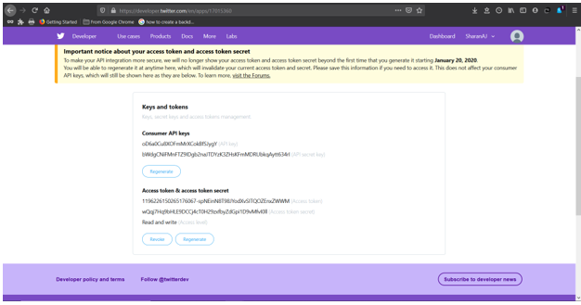
Generation of keys and tokens
The respective Consumer API keys such as API key and API secret key, Access tokens and Secret Access tokens were generated which is further used in the flume configuration file.

Slide 11
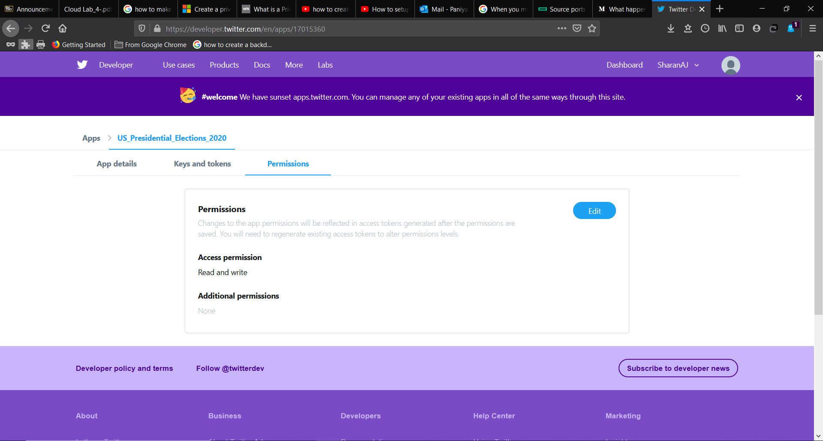
Permission from Twitter

Slide 12
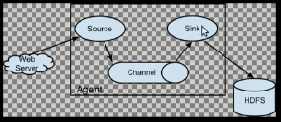
Data Ingestion-Apache Flume
Flume is a data ingestion and integration tool that helps to extract the data from different sources into HDFS.
Flume agent is an important part of flume and consists of the following:
Source 2. Channel 3. Sink
Flume agent should be created to load the data from twitter to HDFS.
The source should be configured as twitter application and the sink or destination should be the HDFS location on to which the data is mounted.
Channel can be any memory channel or netcat. Memory channel is used in this project.

Slide 13
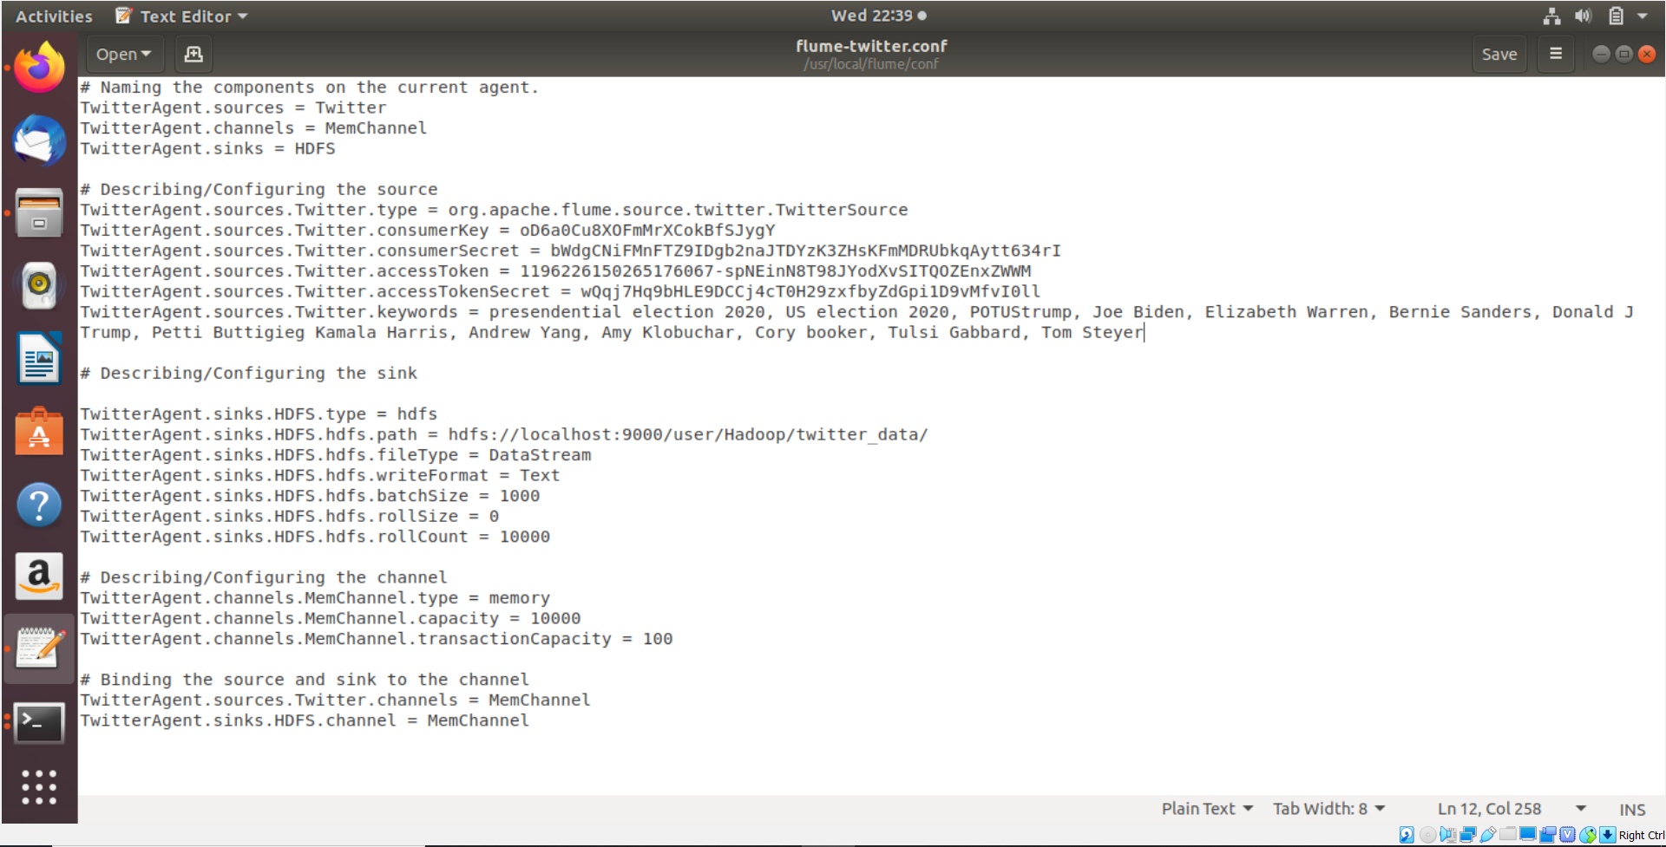
Configuring Flume Agent
Apache flume paths were given into the .bashrc file to configure with HDFS.
A flume twitter.conf file was created in which the Source, Channel and sink were configured. In this conf file keywords are given that were required in retrieving data from Twitter.

Slide 14

Source
This source needs the details such as Consumer key, Consumer secret, Access token, and Access token secret of a Twitter application. While configuring this source, we have provided values to the following properties.
Source type : org.apache.flume.source.twitter.TwitterSource
consumerKey − The OAuth consumer key
consumerSecret − OAuth consumer secret
accessToken − OAuth access token
accessTokenSecret − OAuth token secret
maxBatchSize − Maximum number of twitter messages that should be in a twitter batch. The default value is 1000 (optional).
maxBatchDurationMillis − Maximum number of milliseconds to wait before closing a batch. The default value is 1000 (optional).

Slide 15
Memory Channel
The memory channel temporarily stores the data. To configure the memory channel the following details were provided.
type − It holds the type of the channel. In our example, the type is MemChannel.
Capacity − It is the maximum number of events stored in the channel. Its default value is 100 (optional).
TransactionCapacity − It is the maximum number of events the channel accepts or sends. Its default value is 100 (optional).

Slide 16
Sink
This sink writes data into the HDFS. To configure this sink,the following details are provided.
Channel
type − hdfs
hdfs.path − the path of the directory in HDFS where data is to be stored.

Slide 17
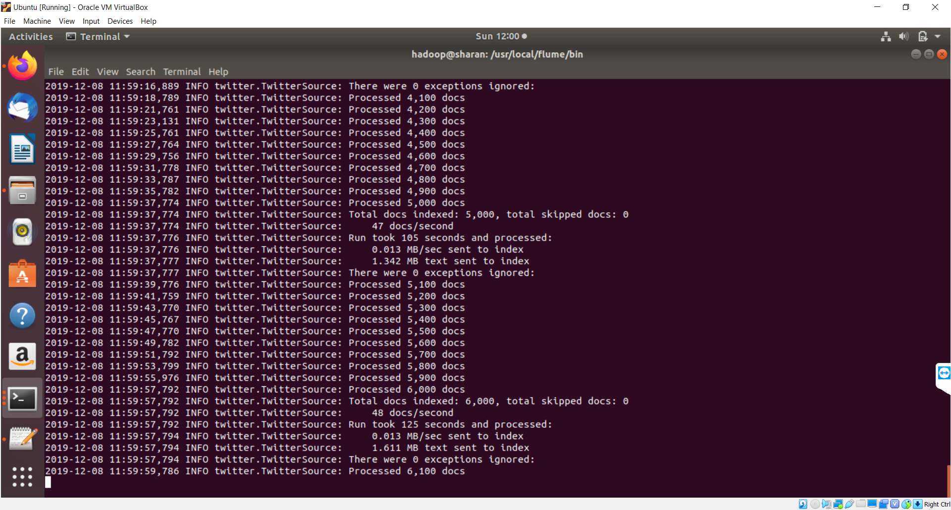
Starting Flume Agent
After configuring the flume agent, flume agent was started which would start importing data from twitter to HDFS.
flume-ng agent -n TwitterAgent -f <location of configuration file>

Slide 18
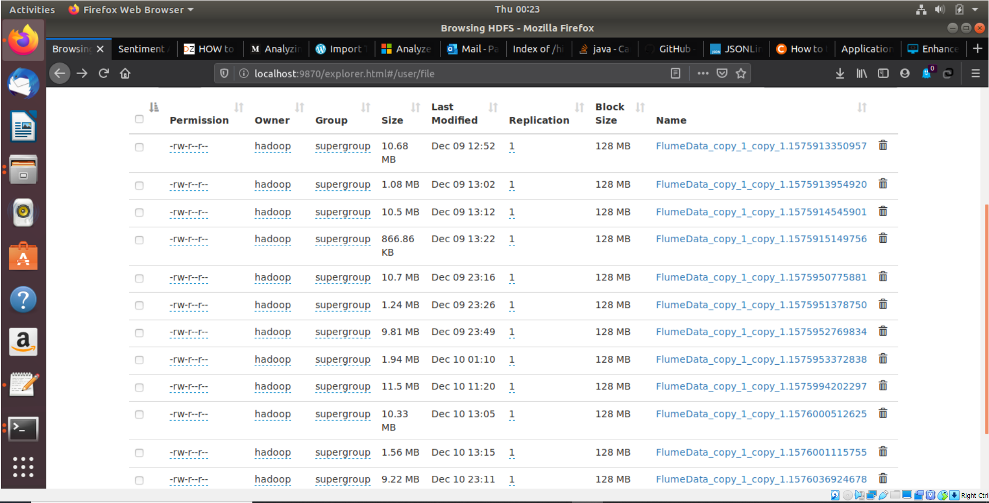
Data Storage - Storing the data in HDFS
Data is loaded to the location specified in sink. This data is in JSON format which is later converted to readable text format during data processing as by default the data coming from twitter is loaded as a Avro file.
Location of files in HDFS, /user/file

Slide 19
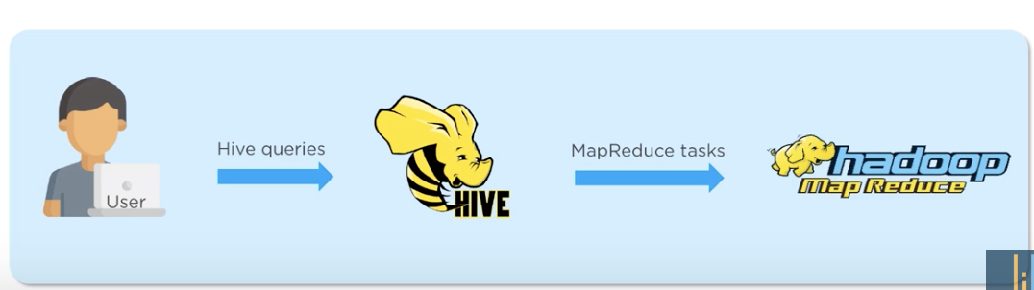
Apache Hive
Hive is data warehouse system which is used for querying and analyzing large datasets stored in HDFS.
Hive uses query language called HiveQL which is similar to SQL.

Slide 20
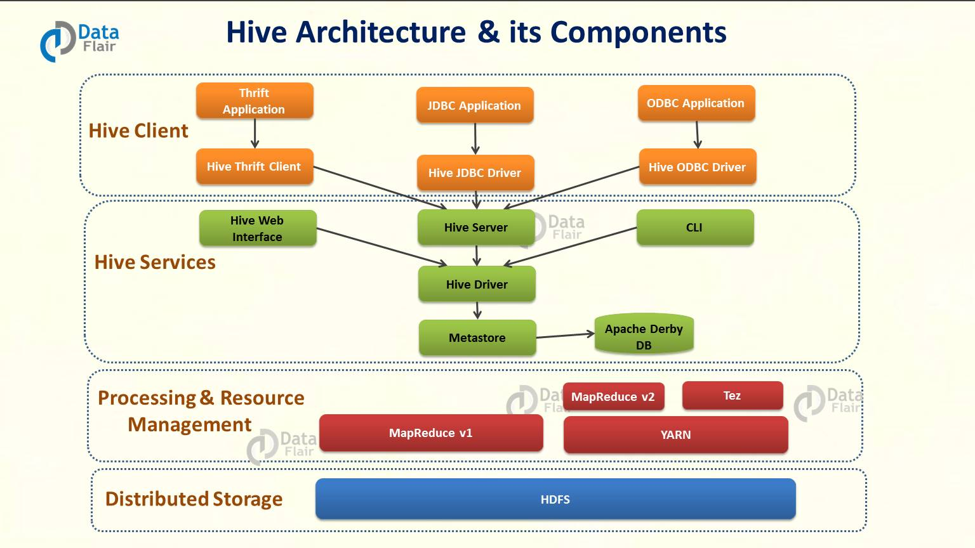
Hive in a nutshell

Slide 21
Features of Hive
It stores schema in a database and processed data into HDFS.
It is designed for OLAP.
It provides SQL type language for querying called HiveQL or HQL.
It is familiar, fast, scalable, and extensible.

Slide 22
Serializer-Deserializer
Apache Hive uses SerDe interface
it handles both serialization and deserialization in Hive. Also, interprets the results of serialization as individual fields for processing.
In addition, to read in data from a table a SerDe allows Hive. Further writes it back out to HDFS in any custom format. However, it is possible that anyone can write their own SerDe for their own data formats.

Slide 23
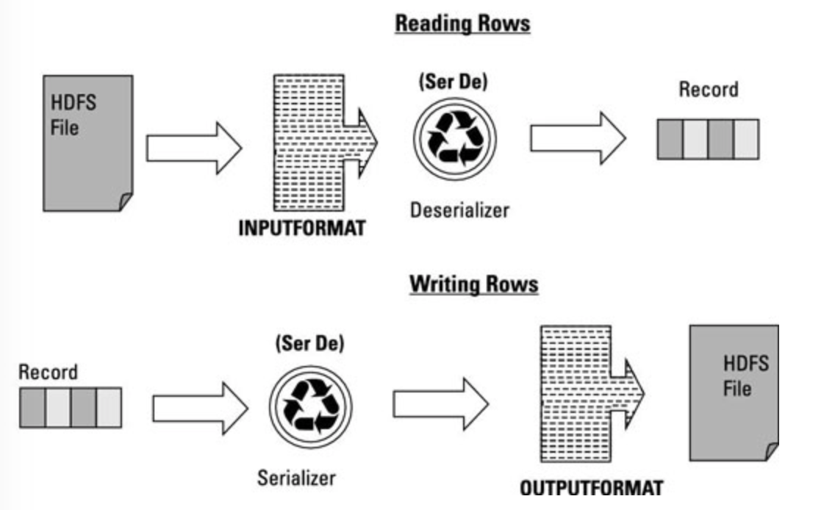
Working of SerDe

Slide 24
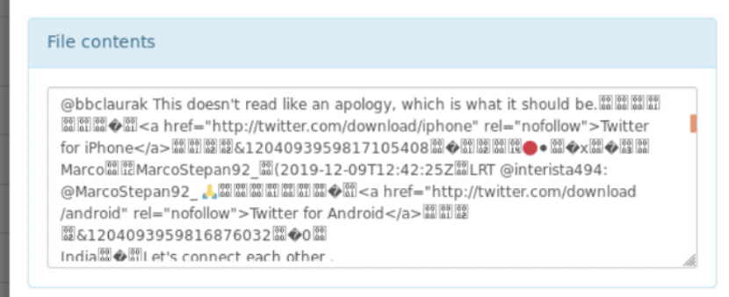
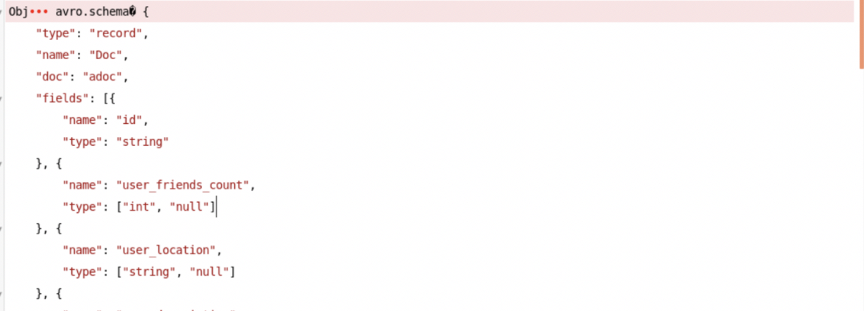
JSON processing
JSON before SerDe
JSON after SerDe

Slide 25
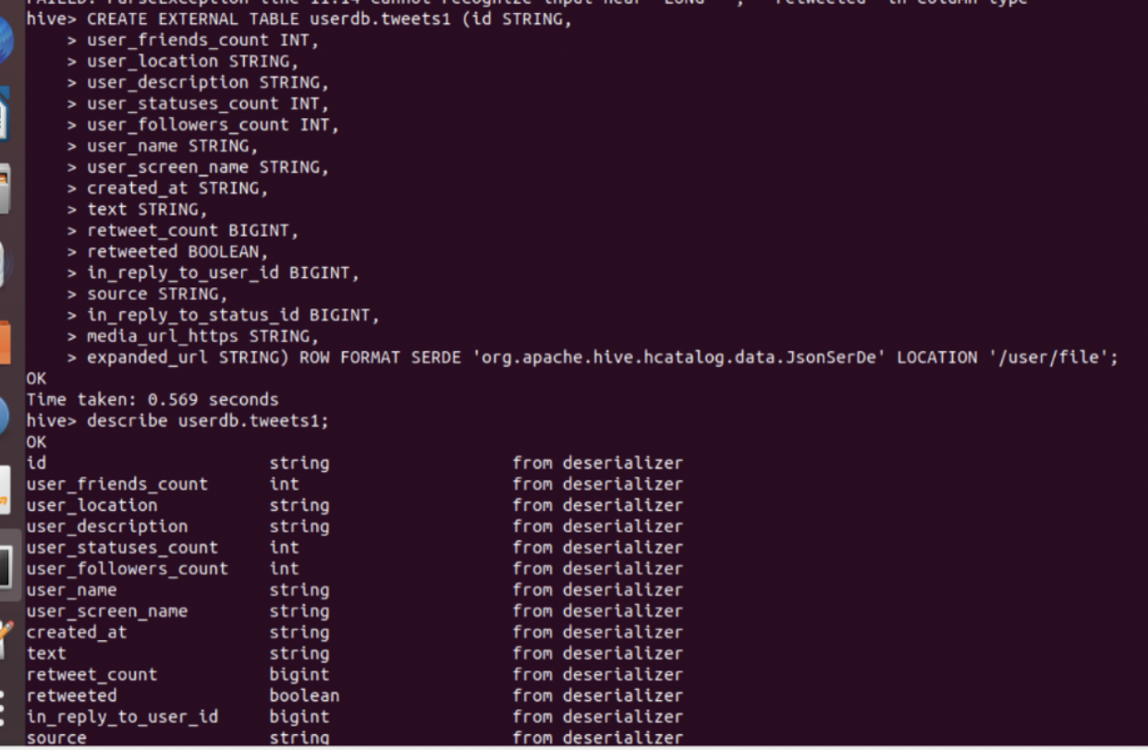
Hive Query
Creating a table

Slide 26
Tokenization
Tokenization is implemented which is a process of breaking down the tweets into tokens.
Example: ‘@mr.beast is rich’. This is broken into tokens like, ‘@ms.beast’, ‘is’, ‘rich’.
Hashtags, URLs, Acronyms and Emojis are considered individual tokens.
White space is used to separate words. A token is identified when encountering a white space.

Slide 27
Normalization
Each token is verified with the normalization process along with some computing performed based on what kind of token it is.
The polarity is determined by searching the emoticon dictionary if the token is an emoticon.
The acronym dictionary is checked if the token is an acronym and the full form is stored as individual tokens.
Uppercase words such as ‘SUPERB’ are called as intensifiers and are converted into lowercase and the token is stored as ‘superb’.
The normalization process also discards all those tokens which, in no way, contribute to the sentiment of a tweet such tokens are called stop word.

Slide 28
Data cleaning
Remove all hashtags
Regex @[A-Za-z0-9]+ represents mentions and #[A-Za-z0-9]+ represents hashtags. Every word matching this regex was replaced with spaces.
Remove URLs
Regex \w+:\/\/\S+ matches all the URLs starting with http:// or https:// and replacing it with space.
Remove punctuations and additional white spaces
Replacing all the punctuations such as .,!?:;-= with space.
Remove @username
Eliminate "@username" via regex matching or replace it with generic word AT_USER

Slide 29
Visualization
By using the hive jar file and custom SerDe files we can store unstructured data into hive table name "tweets" in the structured format.
The figure demonstrates the structured data stored in table named “tweets". And this is also our input data in which sentiment analysis is clone.
The set of data were taken from the social media platform Twitter using Twitter Streaming APIs (application program interface).
Further it was passed through Apache Flume. These fetched datasets (tweets) are stored in HDFS. The figure shows the tweets data in flume directory and it represents the list of twitter data extracted which contains the keyword as specified in the configuration file.
We can check the files by downloading them and seeing the tweets relating to the keyword.

Slide 30
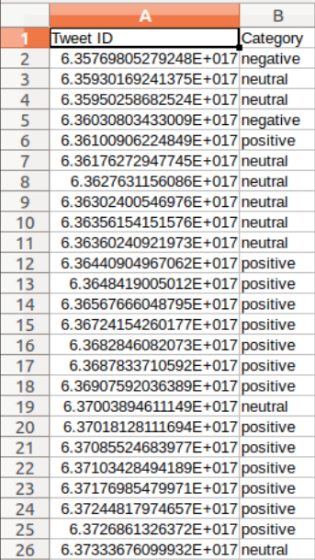
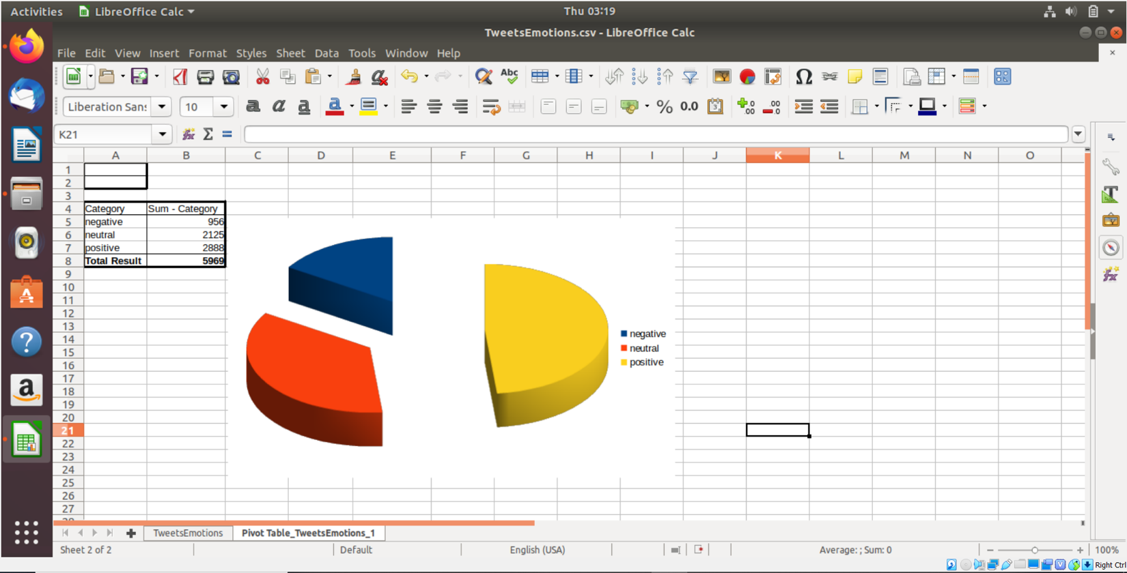
Data Visualization

Slide 31
Thank you

